Slide 1
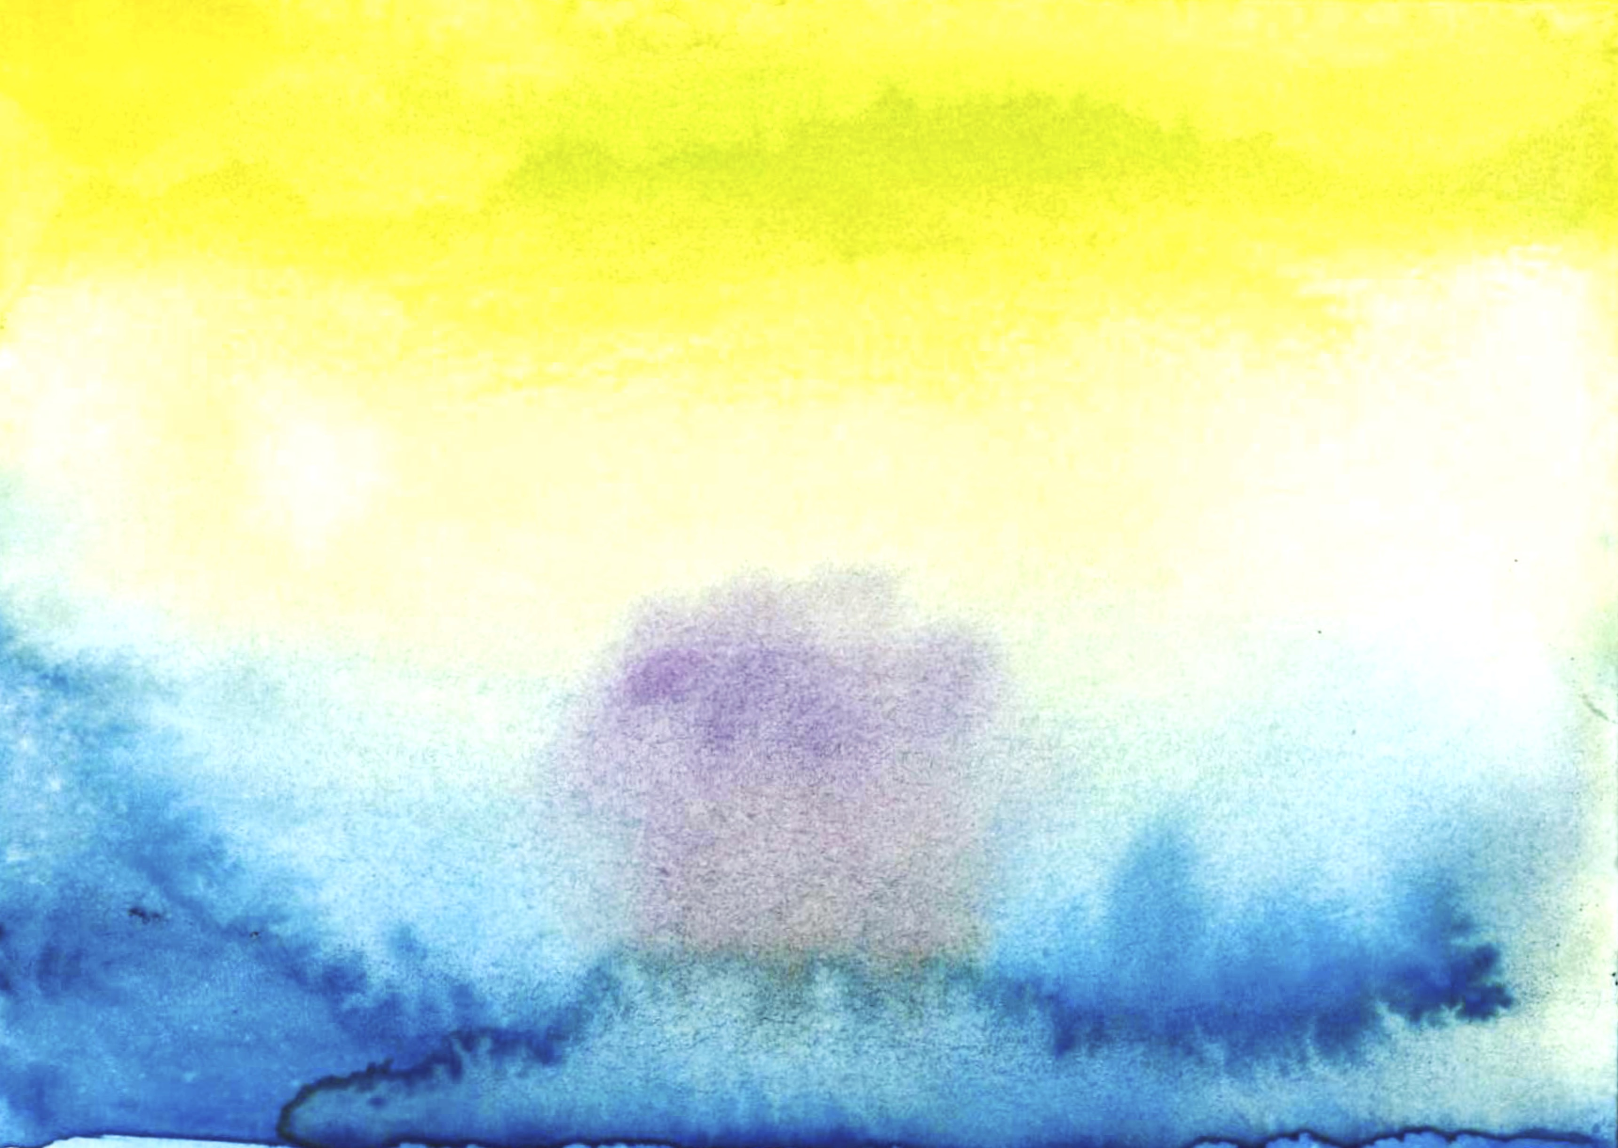
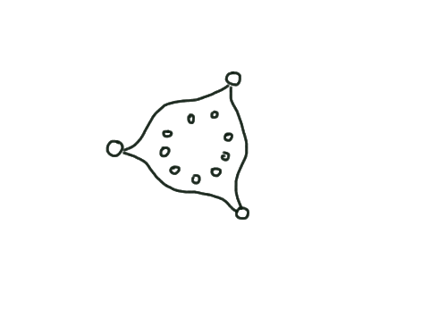
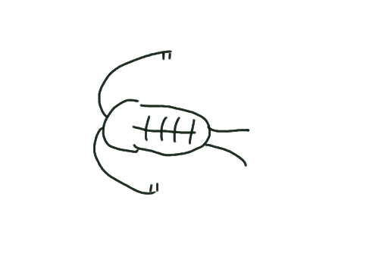
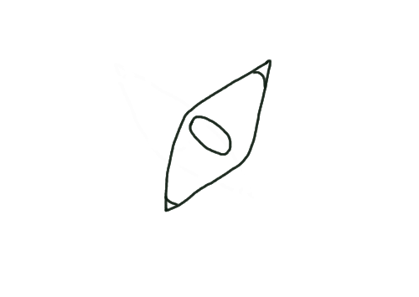
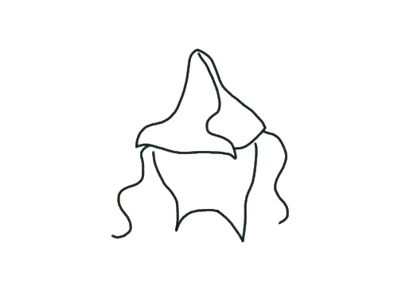
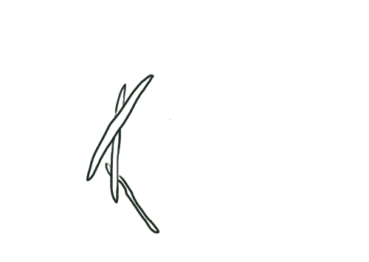
Oligotrophic region
Upwelling region
Oligotrophic region
Warming
Warming
Warming
Diazotroph PP
N₂ fixation
P*
Grazing
& light
control
Iron
(nutrient)
control
P*
Diazotroph PP
N2 fixation
Reduced
upweilling
Export
Export
Oxygen Deficit Zone
Denitrification
Ignore
Iron
With
Iron

