Slide 1
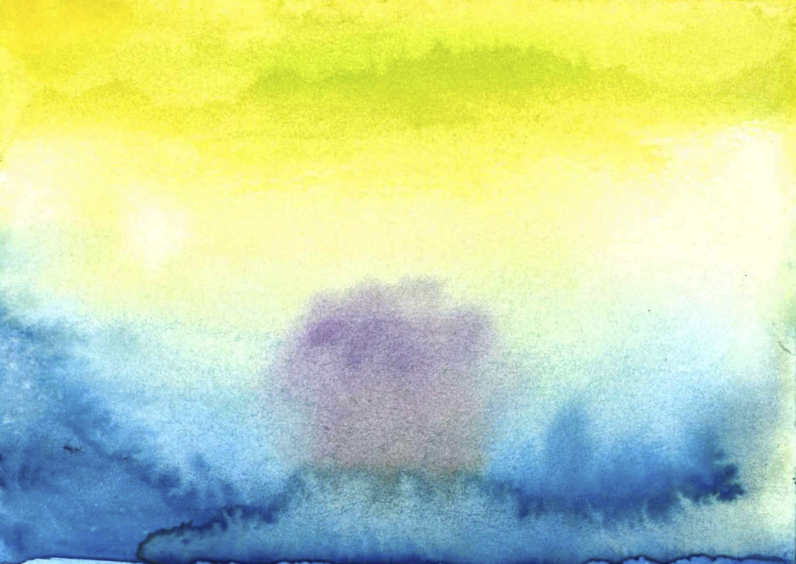
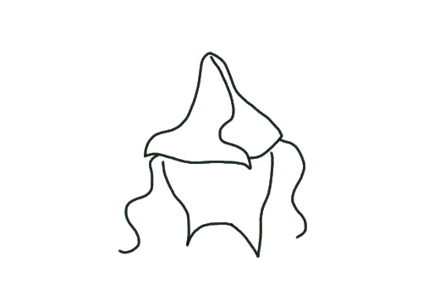
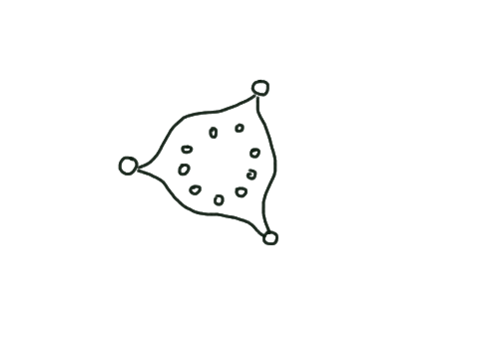
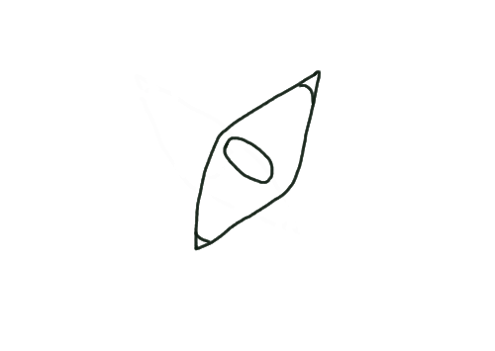
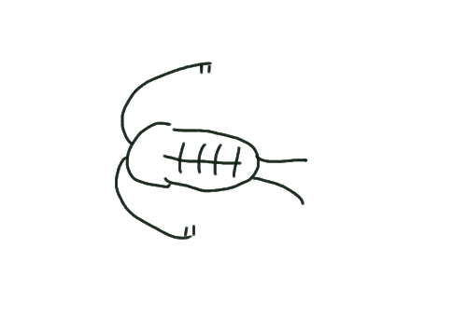
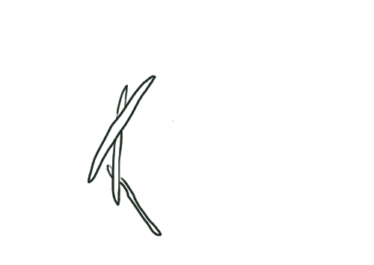
Oligotrophic region
Upwelling region
Oligotrophic region
Warming
Warming
Warming
Diazotroph PP
N₂ fixation
Grazing & light control
Iron
(nutrient)
control
Diazotroph PP
N₂ fixation
P*
P*
Export
Export
Reduced
upweilling
Oxygen Deficit Zone
Ignore
Iron
denitrification
With
Iron

