Slide 1
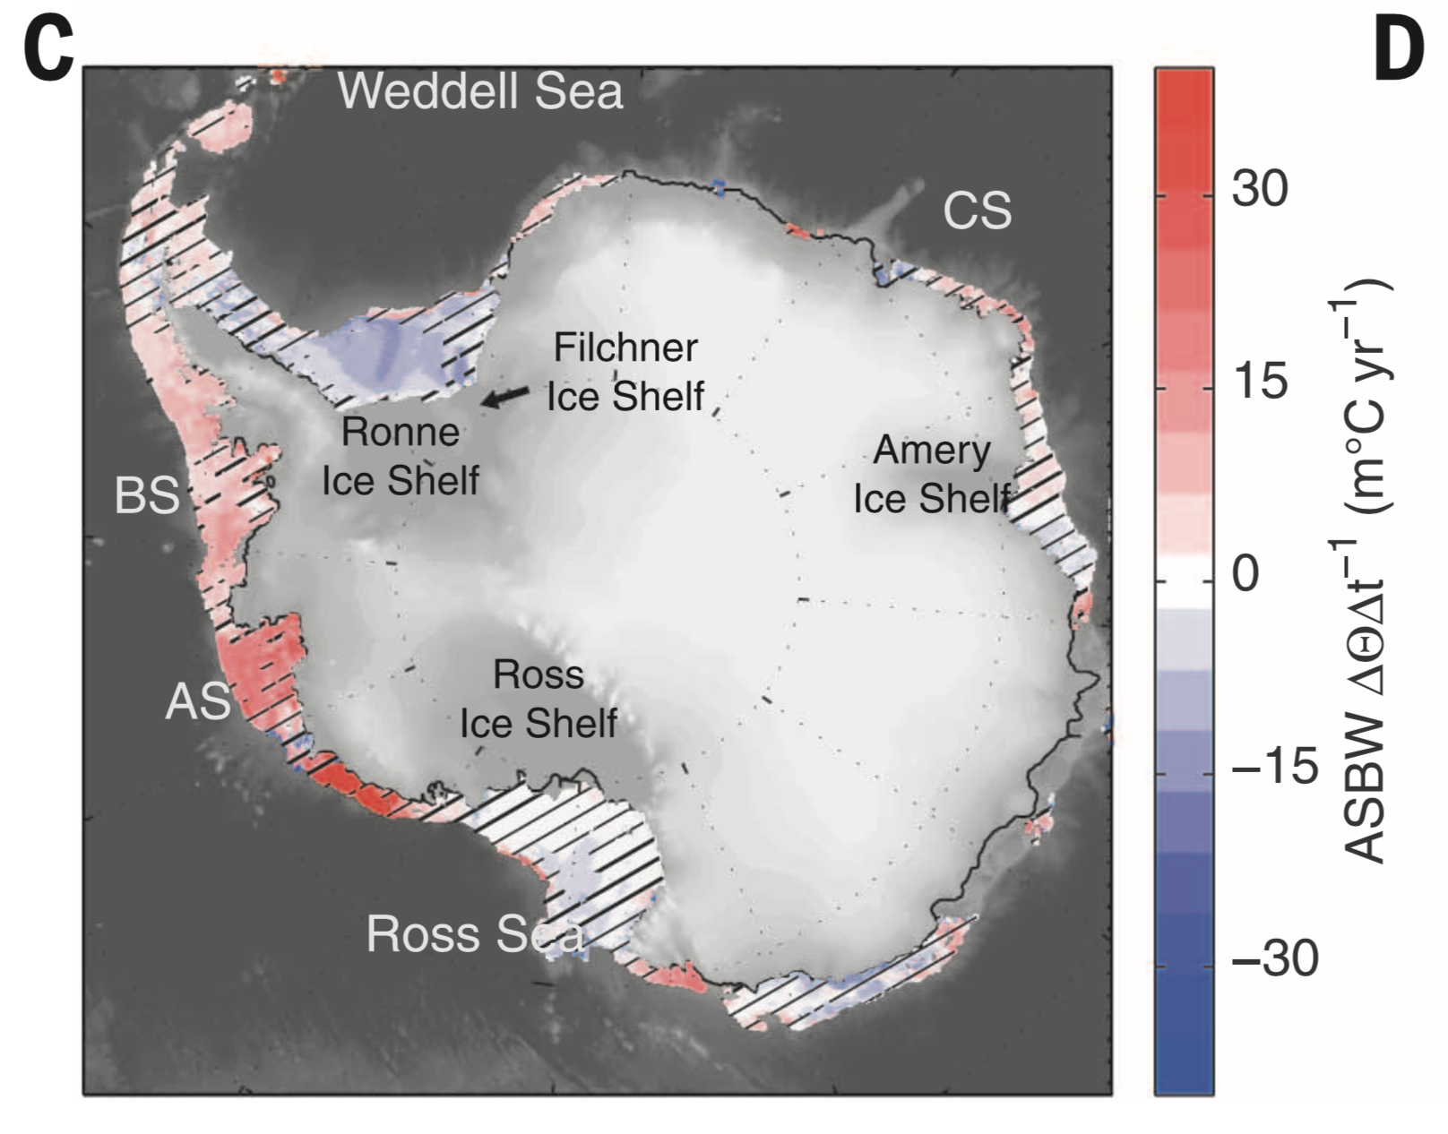

(a)
(b)
MOMSO
OBSERVATION

