Slide 1
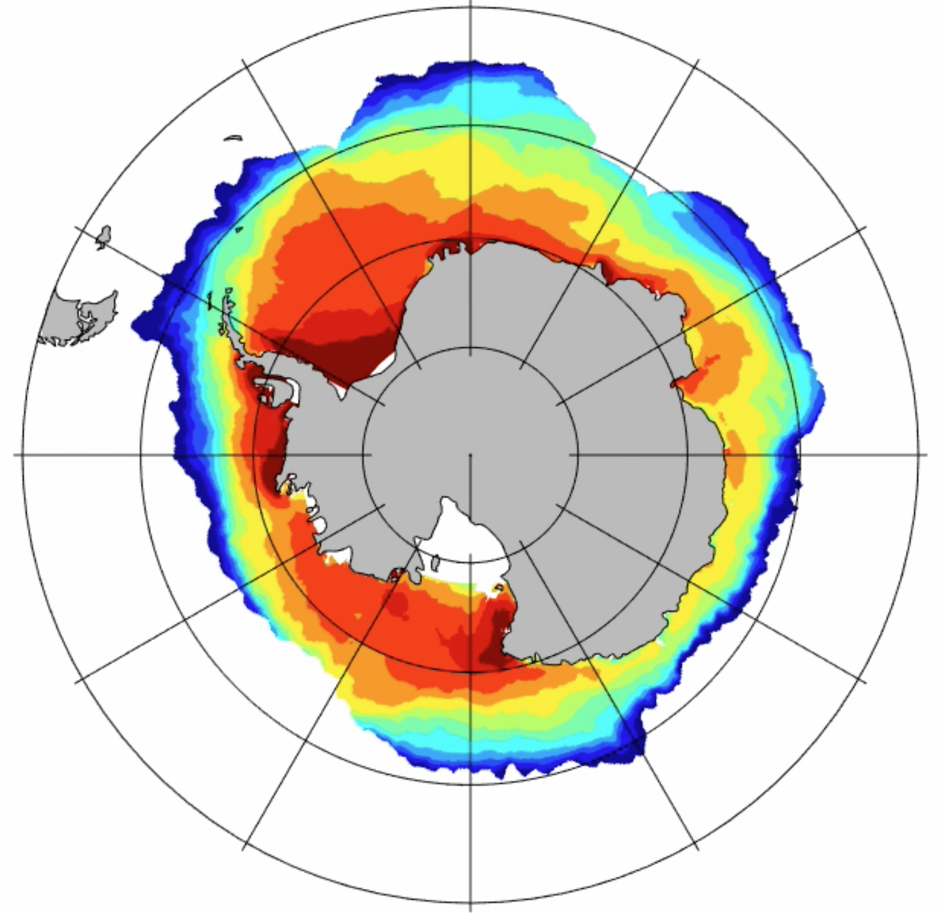
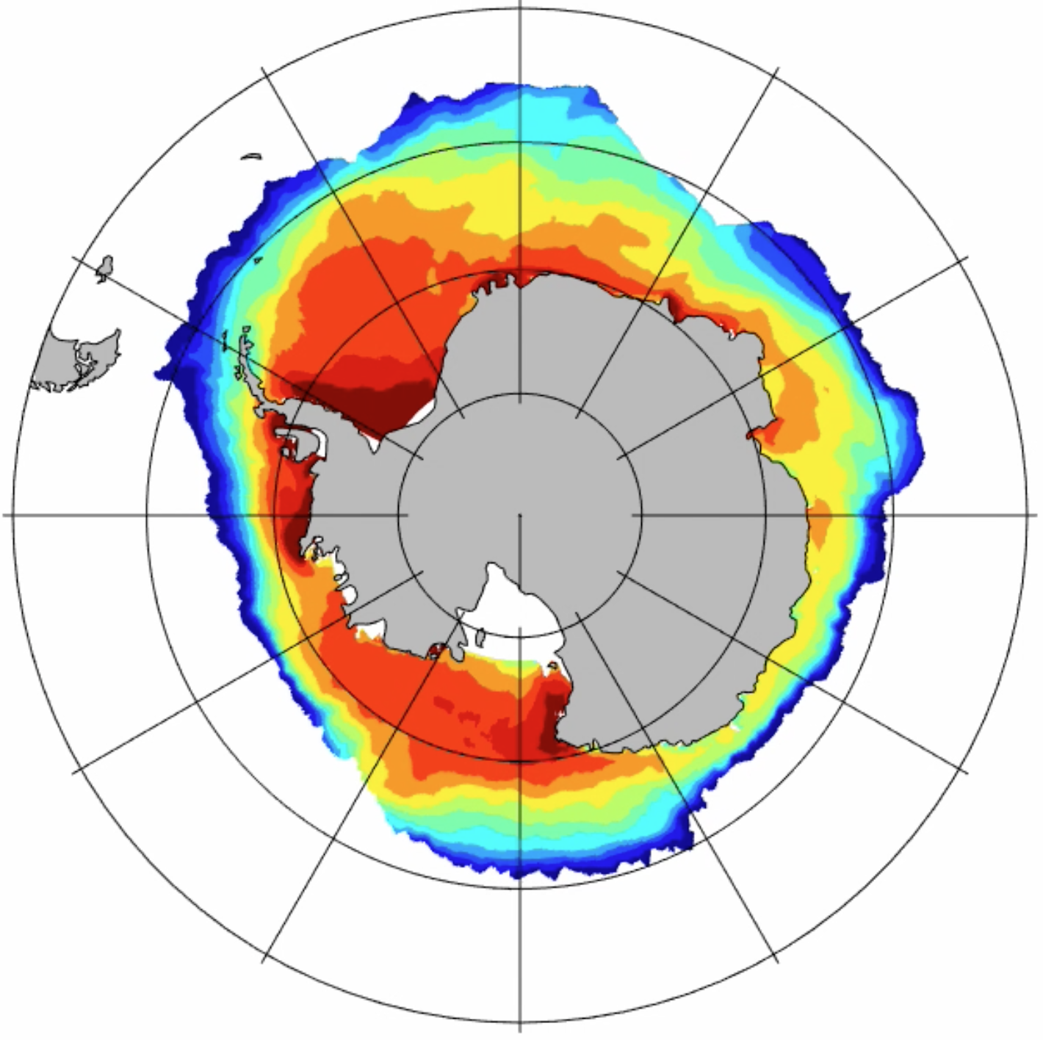
HadISST
reference
increasing wind
Notes:
HadIsst: 1980 – 2000 average; reference + increasing wind: nominal year 2022

