Slide 1
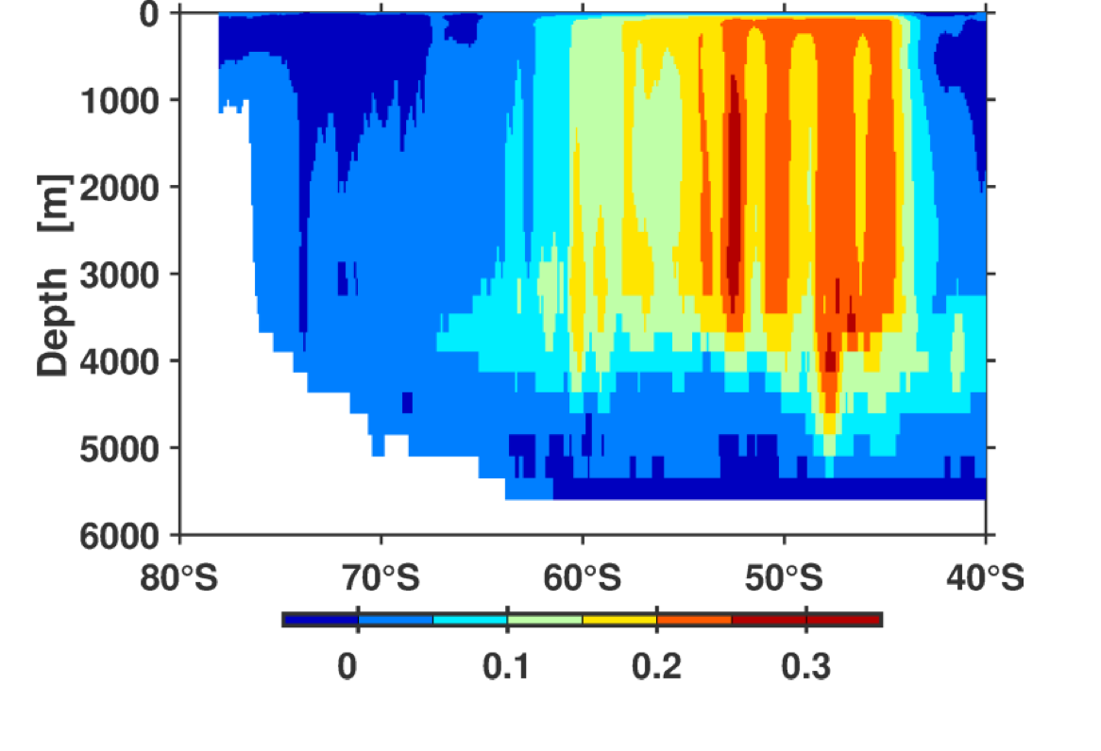
[Sv/yr]

